Slide 1

TITLE – TaskVerse WebApp
KPR Institute of Engineering and Technology
INNOVSENSE 2025
Team Head : Madhesh K
Department | Students
1) Computer Science and Engineering 2) Artificial Intelligence and Data Science | 1) Madhesh K (2303711310421060) 2) Karthikeyan V (2303711310421051) 3) Mathan M (2303711310421061) 4) Sanjai Kumar S B (2303711324321036) 5) Kavin Vikraman S R (23031711310421055)

Slide 2
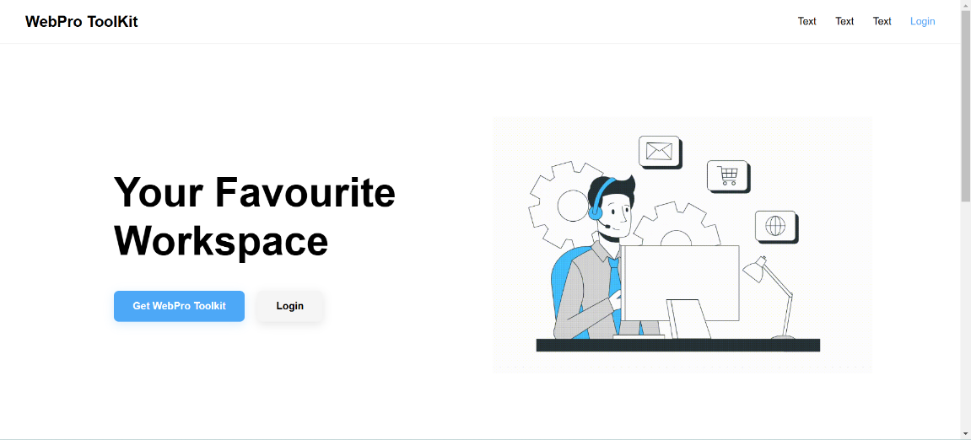
Objective
TITLE: TaskVerse - The Web-based Tool for Productivity and Efficiency
OBJECTIVE:
To build a web based Comprehensive Productivity software to enhance the people productivity and efficiency.

Slide 3




Features
Productivity Service
Users can create, manage, and track their daily tasks. Also helps to build new habits.
2. Collaboration Service
Users can create projects, invite teammates, and track progress.
3. File management Service
People would able to convert files ,extract text from image and some file management tasks.
4. Editor Service
Provide a IDE for developing codes and a Notepad to take notes or create docs.

Slide 4
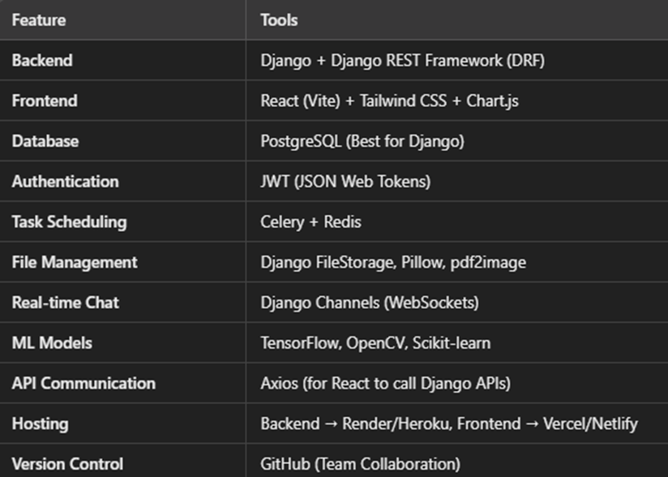
Methodology

Slide 5
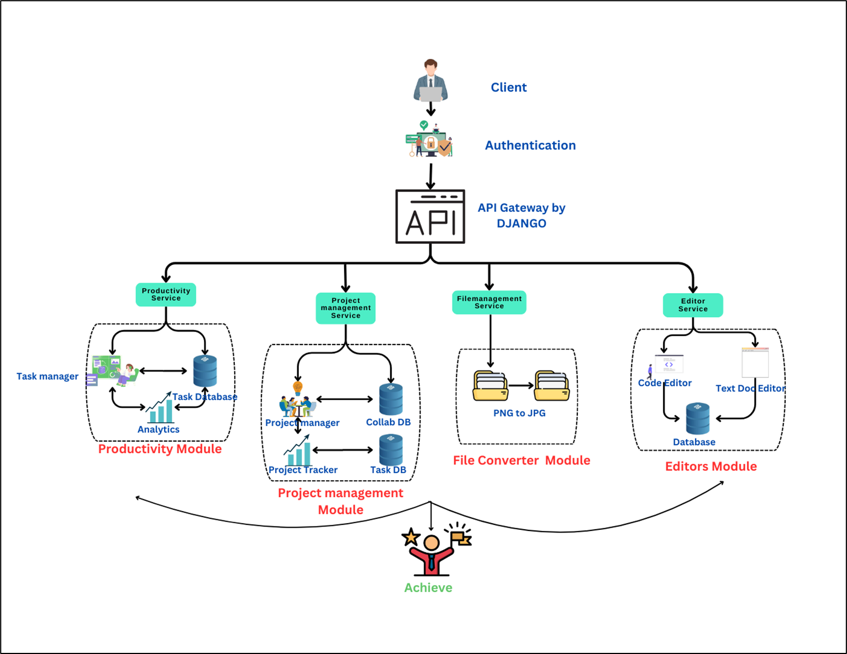
Block Diagram

Slide 6
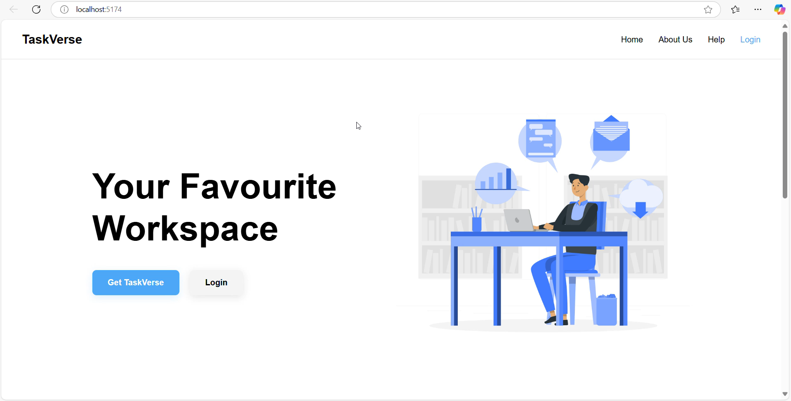
Working/Simulation video

Slide 7
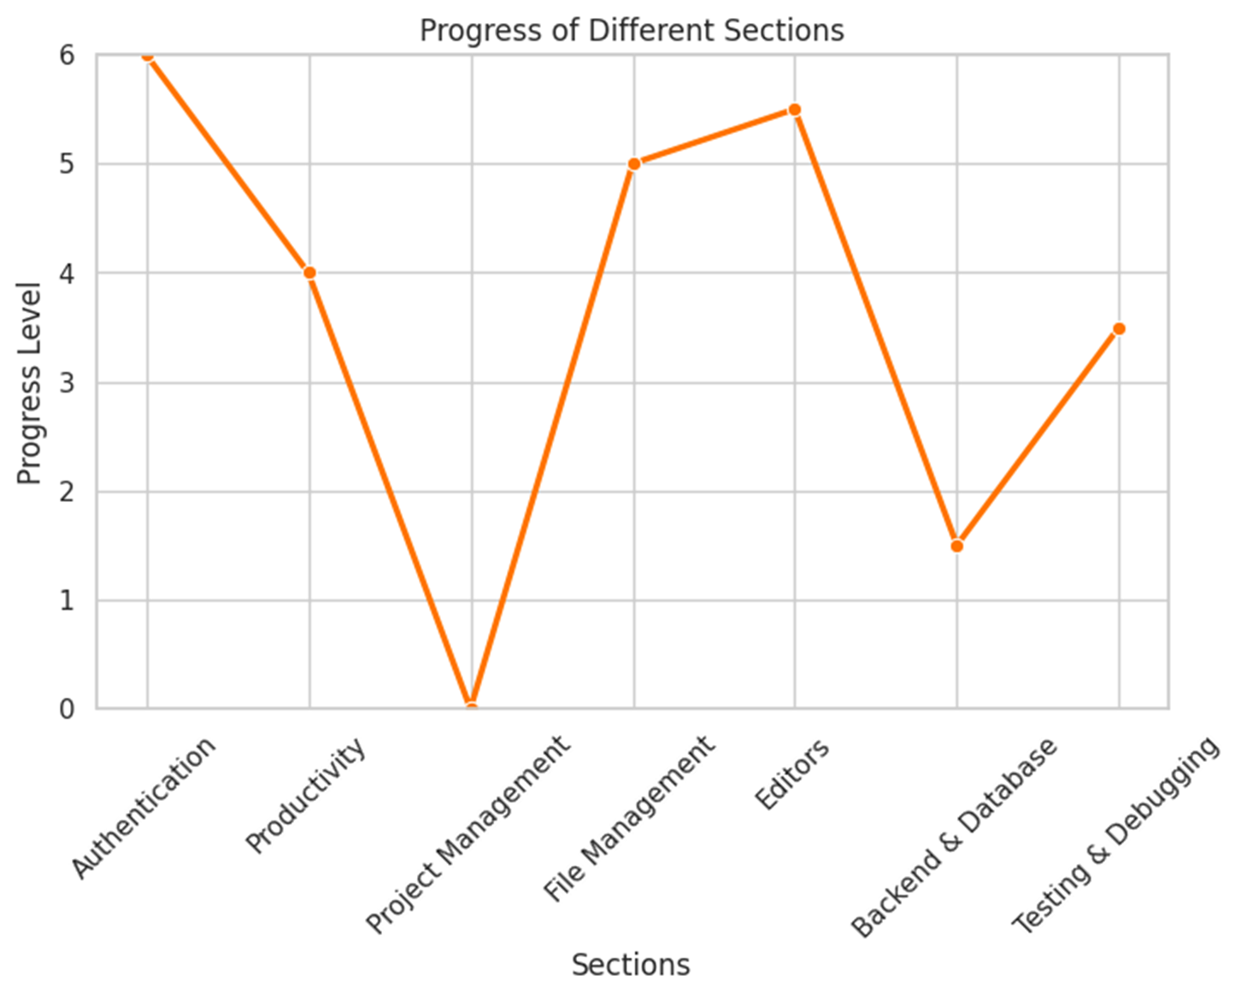
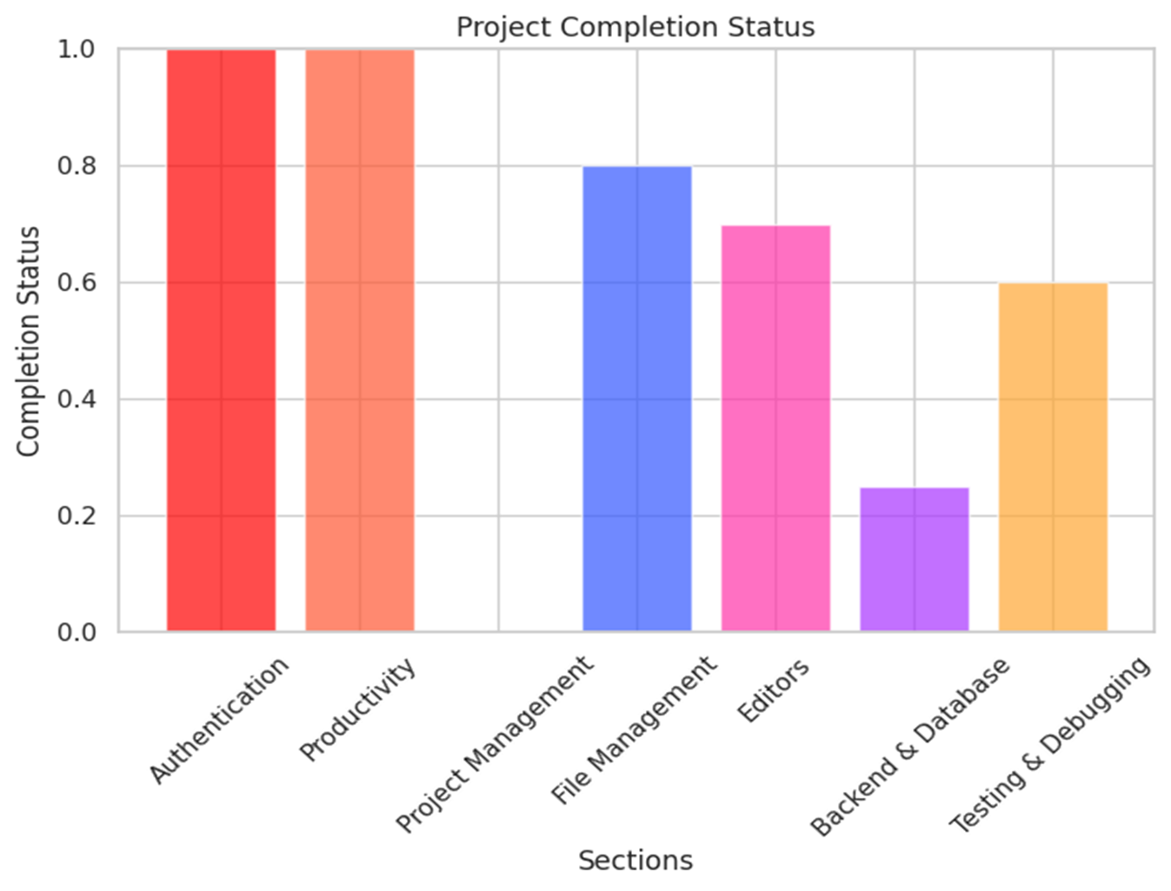
Target Achievement Status

Slide 8


